Slide 1
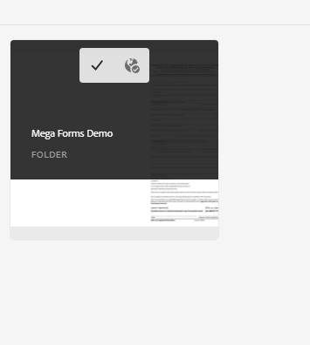
Mega Forms Demo Folder

Slide 2
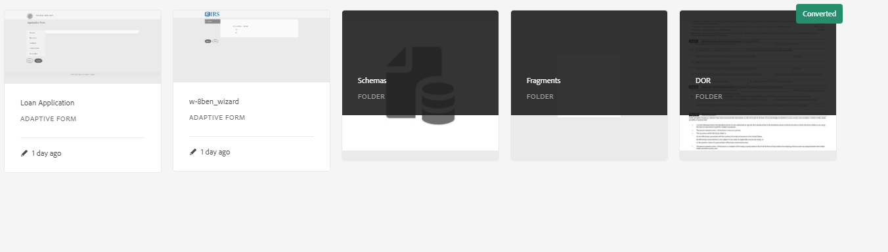
Demo Assets

Slide 3
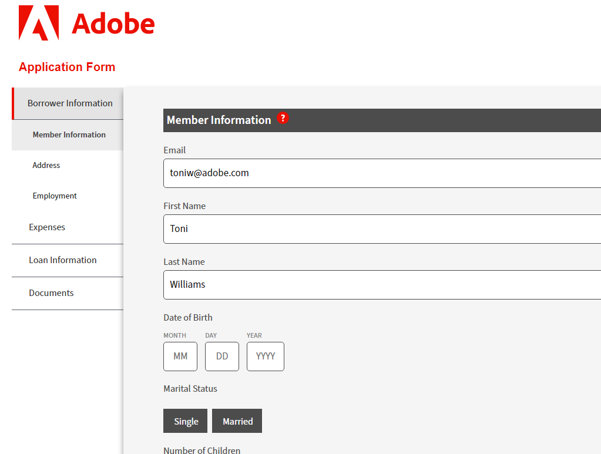
Loan Application Adaptive Form

Slide 4
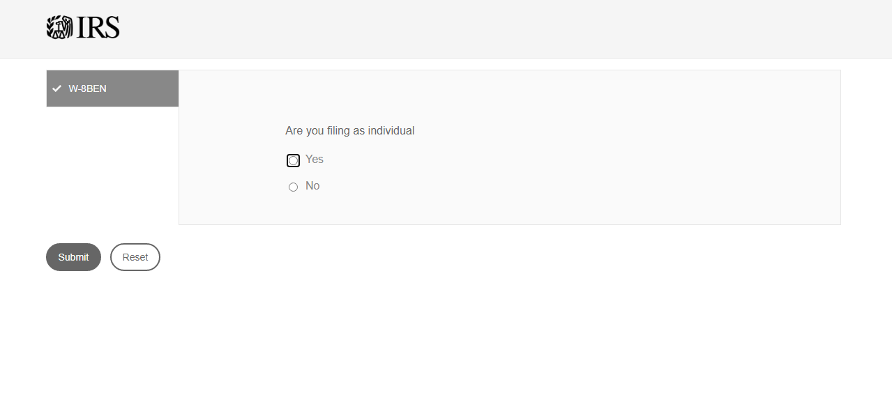
W-8BEN Adaptive Form

